Slide 1



Slide 2
Functioning of the judicial system of Ukraine in martial law

Slide 3
How the judicial system works during the war
For today, 119 courts are closed due to the aggression of the russian federation. Some of them - 47 courts - are located in uncontrolled territory.
32 court buildings were destroyed in Ukraine. Some of them were partly destroyed, in some of them there was simply nothing left. The Kharkiv Court of Appeal, which has just been restored, has been badly damaged. It is an architectural monument that was destroyed worse than the Nazis did during World War II. Borodyanka City Court was completely destroyed, Izyum Court was severely damaged. The Pokrovsky Court, the Chernihiv Court of Appeal and many other courts have been severely damaged.
As of February 24, 115,000 cases have been made in Ukraine. This means that the courts continue to work as they should.

Slide 4
Reformatting the judicial system in war times
There are three main types of courts depending on the territories in which they are located:
The first is the courts that are under occupation. It is impossible to administer justice there in any way. The Supreme Court has already made a number of decisions to change the jurisdiction of cases heard in these courts.
The second is the courts located in the territories where active hostilities are taking place. Everything happens differently there. Where the situation is critical, operational decisions to suspend the courts are made by the assembly of judges, as well as territorial divisions of the State Judicial Administration.
The third type - the courts in the rear, whose activities, in fact, have not changed.

Slide 5
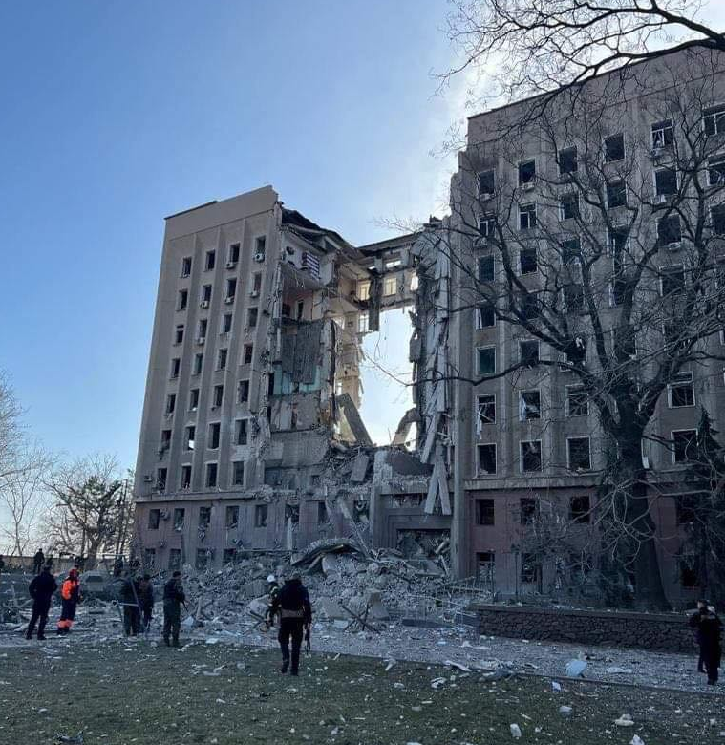
The Commercial Court of the Mykolaiv Region and the Mykolaiv Court of Appeal
As a result of attack in Nikolaev the employee of Court of Appeal is wounded. «On April 15, 2022 during shelling of Nikolaev there was a tragedy - the employee of the Nikolaev Court of Appeal Alexey Parakonny who works in court since 2011 is wounded. The head of the organizational and legal department of the court, Nadiya Torkhova, born in 1978, and the secretary of the court session were also killed. The head of the analytical and statistical department of the court, Vira Panchenko, born in 1985, was also seriously injured.

Slide 6
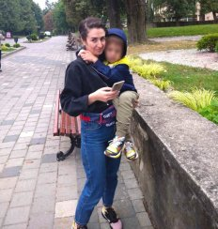
A female worker of the Donetsk Court of Appeal died from the shelling
On February 13,2022, During the rocket shelling in Mariupol Anastasia Kostomanova died.She was a leading specialist in the judicial statistics department of the Donetsk Court of Appeal,who has worked in the court since 2012.She was to turn 31 in April.Sasha 7-years old boy was left without a mather.

Slide 7
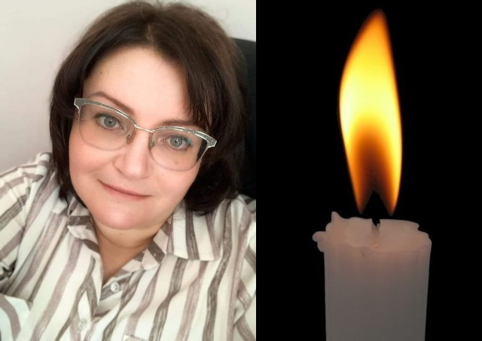
Rashists shot a judge near Chernihiv
On March 3, 2022, Judge of the Chernihiv Court of Appeal Lyubov Kharechko died. The car in which she was evacuated along with her 2 small sons and other people was fired upon by the russian military.

Slide 8
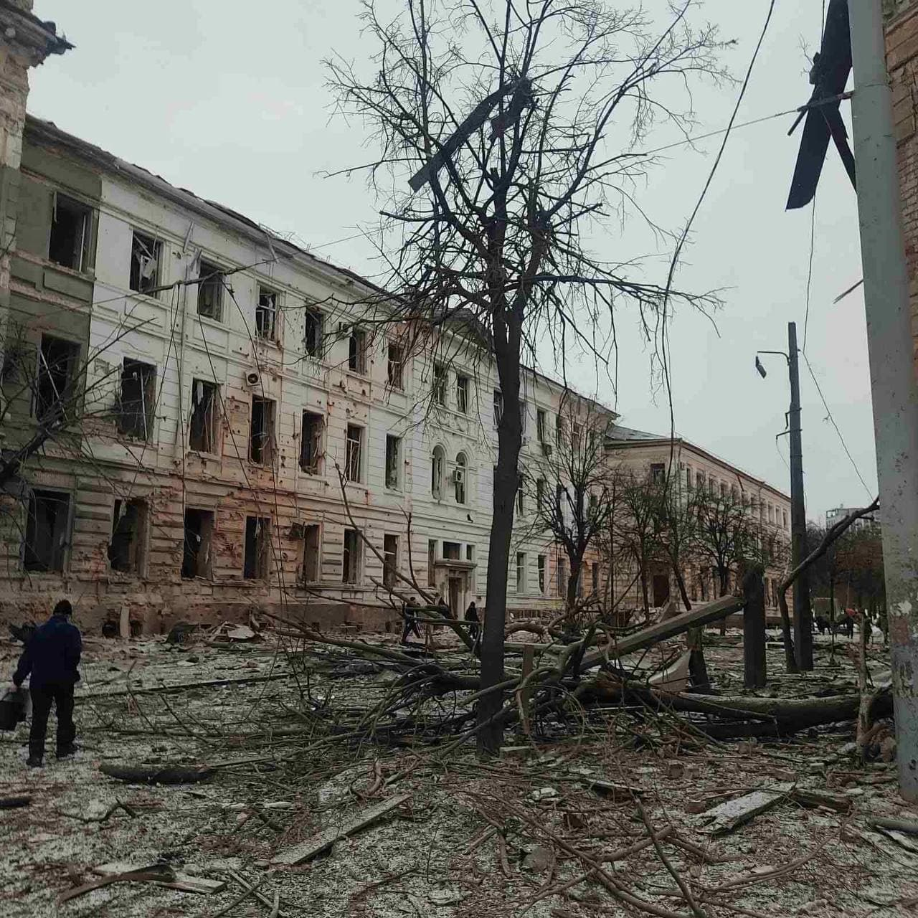
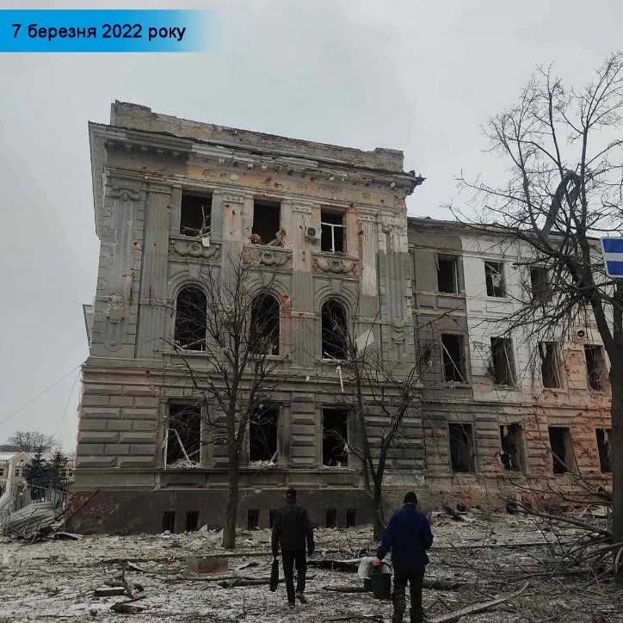
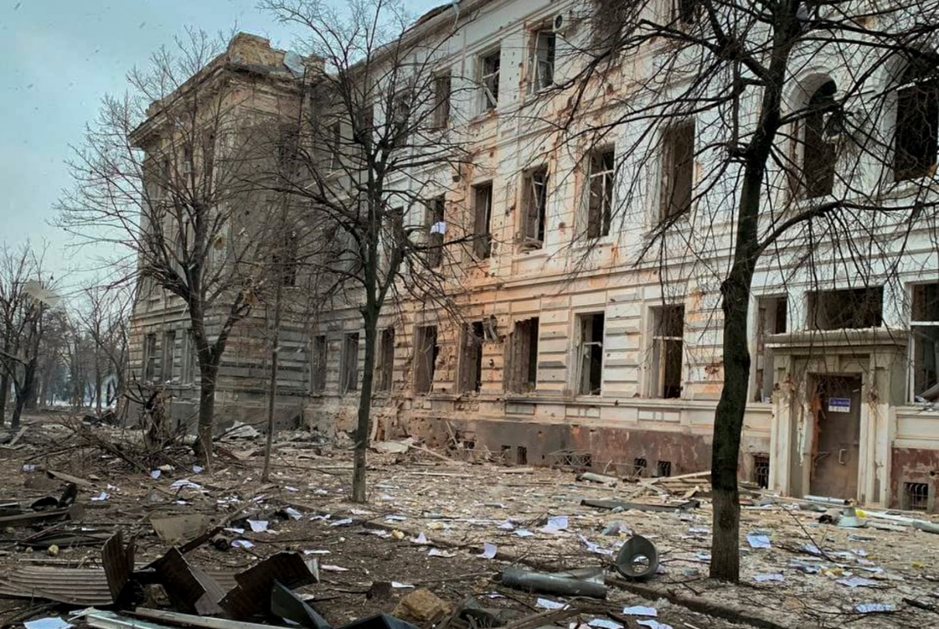
Kharkiv Court of Appeal
On March 6, 2022, at about 7:20 p.m., two powerful explosions occurred near the building of the Kharkiv Court of Appeal, as a result of which the building suffered significant damage. The blast completely knocked out the windows, significantly damaged the interior, burned the roof.

Slide 9
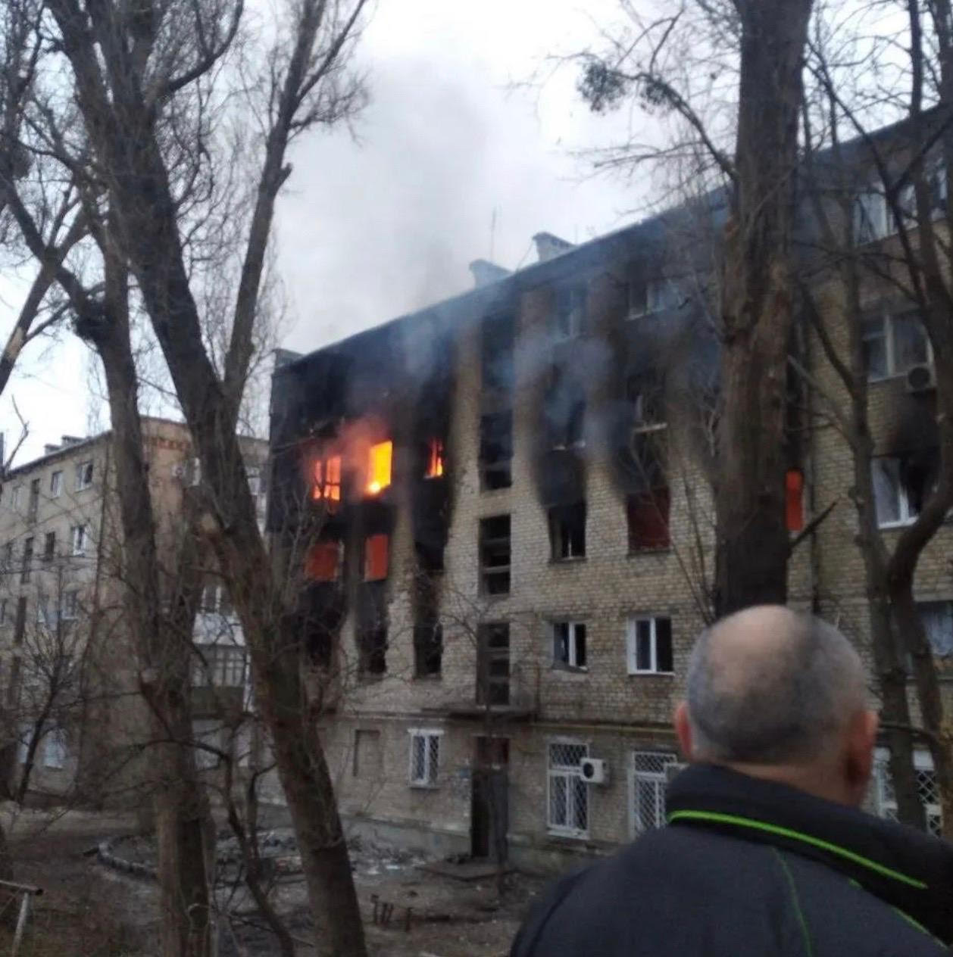
Izyum City Court
The Izium City Court of Kharkiv Region was damaged as a result of massive bombings and artillery shelling. In a court located on the ground floor of a five-story building, a blast shattered windows around the perimeter, partially shattered interior doors, and damaged interiors. Judges and court staff were not injured. Representatives of the Judicial Security Service, who were in the room during the bombing, managed to hide in the basement.

Slide 10
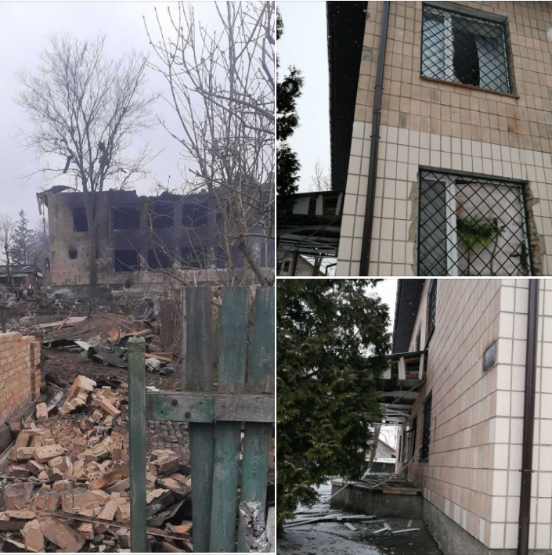
Borodyanka district court of Kyiv region
A two-storey court building in Borodyanka village was completely destroyed. The building was attacked several times. During the first attack, among other things, windows and doors were broken. Eventually, under a barrage of occupier attacks, the administration building suffered critical damage. Fortunately, none of the court employees were injured.

Slide 11

Damage to court buildings by the Russian occupiers

Slide 12
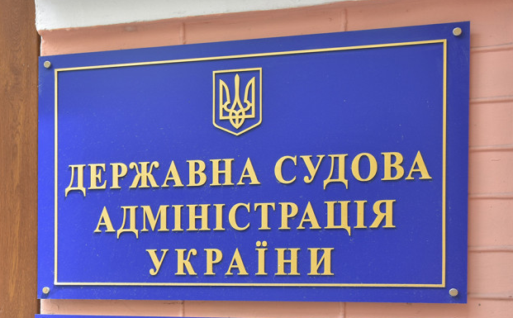
The judiciary transferred 64 million UAH to the needs of the Armed Forces
In addition to the officially confirmed amount of over 64 million UAH, judges, court staff and the SJA of Ukraine are involved in other activities for our Victory: helping refugees, volunteers, buying first aid kits, donating to charitable foundations and supporting the Territorial Defense Force.

Slide 13
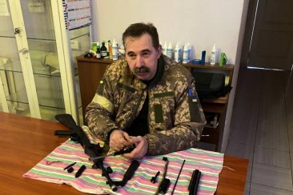
Judges joined the Armed Forces of Ukraine
Sixty judges went to the Armed Forces or the Territorial Defense. Hundreds of court staff are at the front. Many judges - women with children - went to Western Ukraine or abroad. Gradually, they are returning, but the shelling of cities and the continuation of hostilities are very slowing down this process. The husband of one of the judges recently tried to return to his house in Bucha and exploded in a mine. Andriy Kalarash said that he went to the military registration and enlistment office because he could not stay at home. His two sons also help the country: the youngest is volunteering, and the eldest has joined a NGO and is involved in night patrols in Odessa to protect the city.
Andriy Kalarash

Slide 14
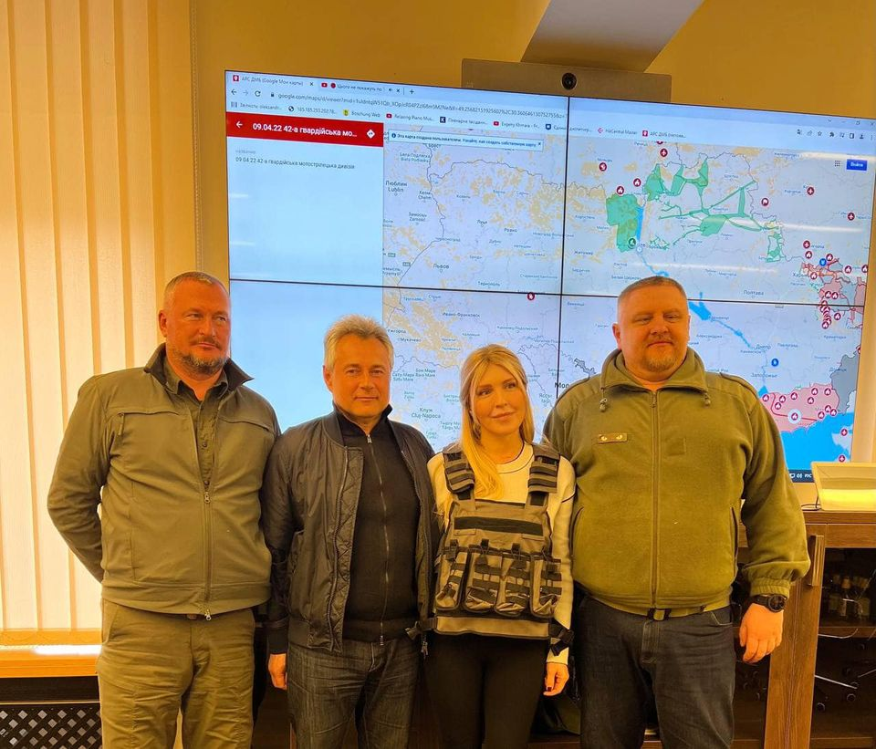
Assistance to soldiers of the Armed Forces of Ukraine
Judges of the Northern Commercial Court of Appeal handed over 50 bulletproof vests of the Kyiv City State Administration to Kyiv residents who are going to the front to defend our state. Mutual support and assistance are extremely important in our difficult times. We believe that our unity, working together both on the military front and on the front of good deeds, will help to overcome these difficult times.

Slide 15
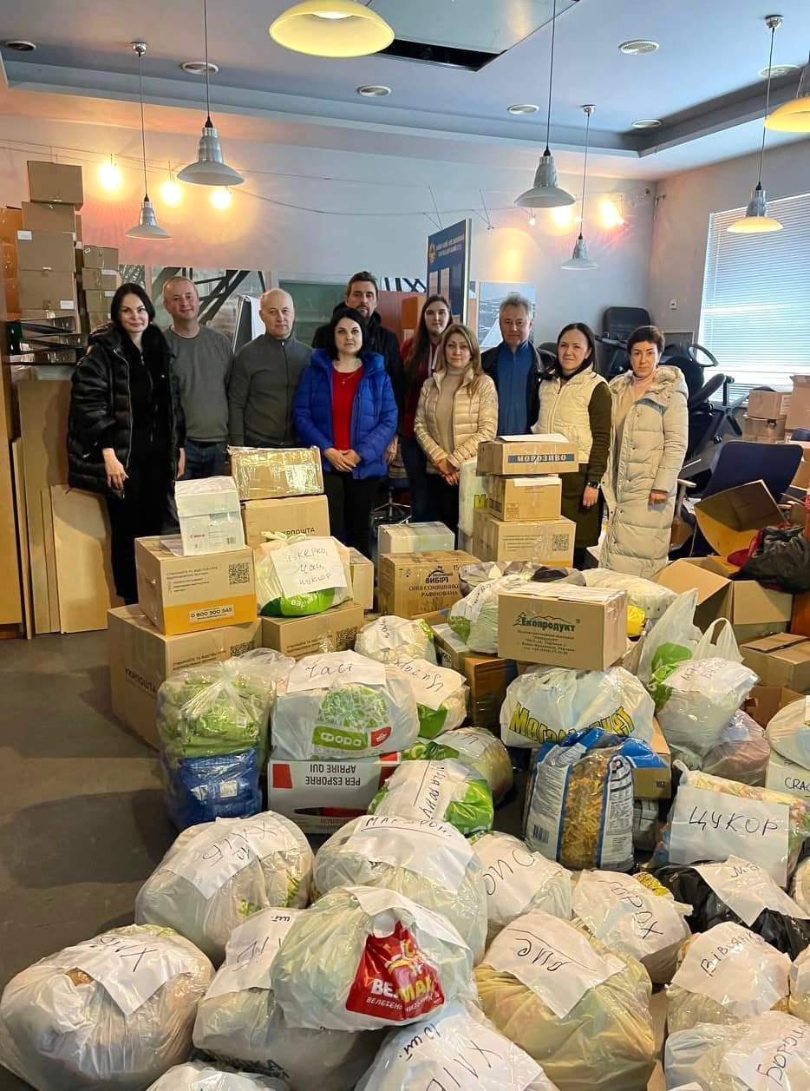
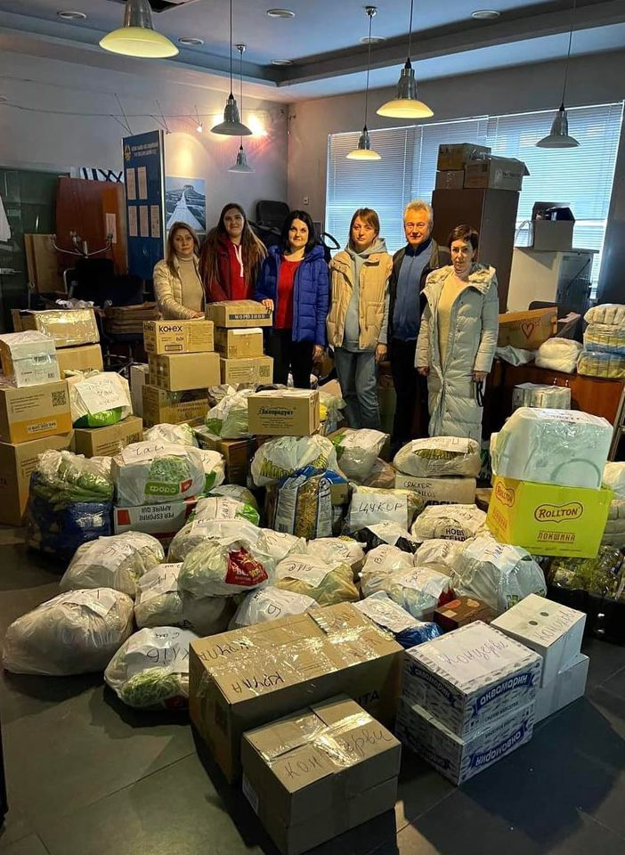
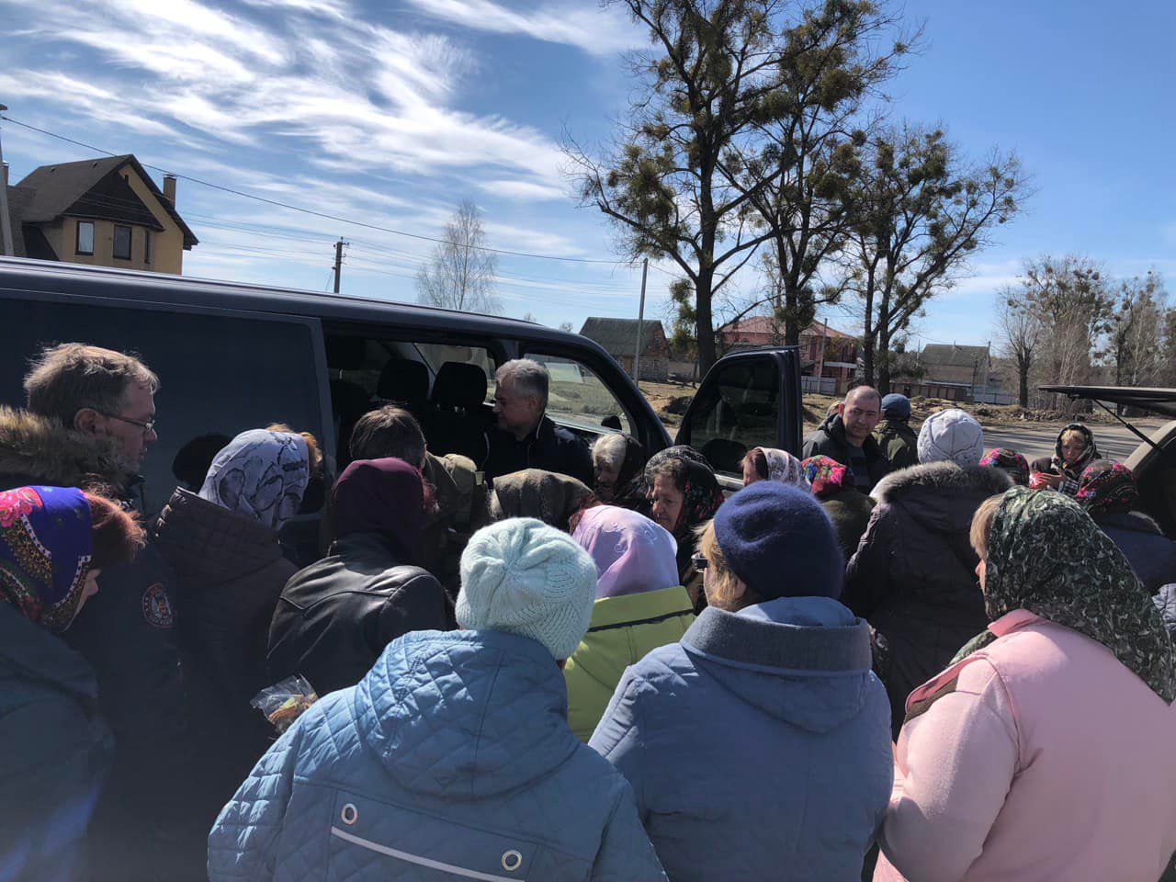
In connection with the humanitarian crisis in Makariv and Borodyanka districts of Kyiv region, judges of the Northern Commercial Court of Appeal organized a collection of aid (food, hygiene products, baby food, etc.) for residents of racist-liberated districts. Judges of the Commercial Court of Kyiv joined the charity event.

Slide 16
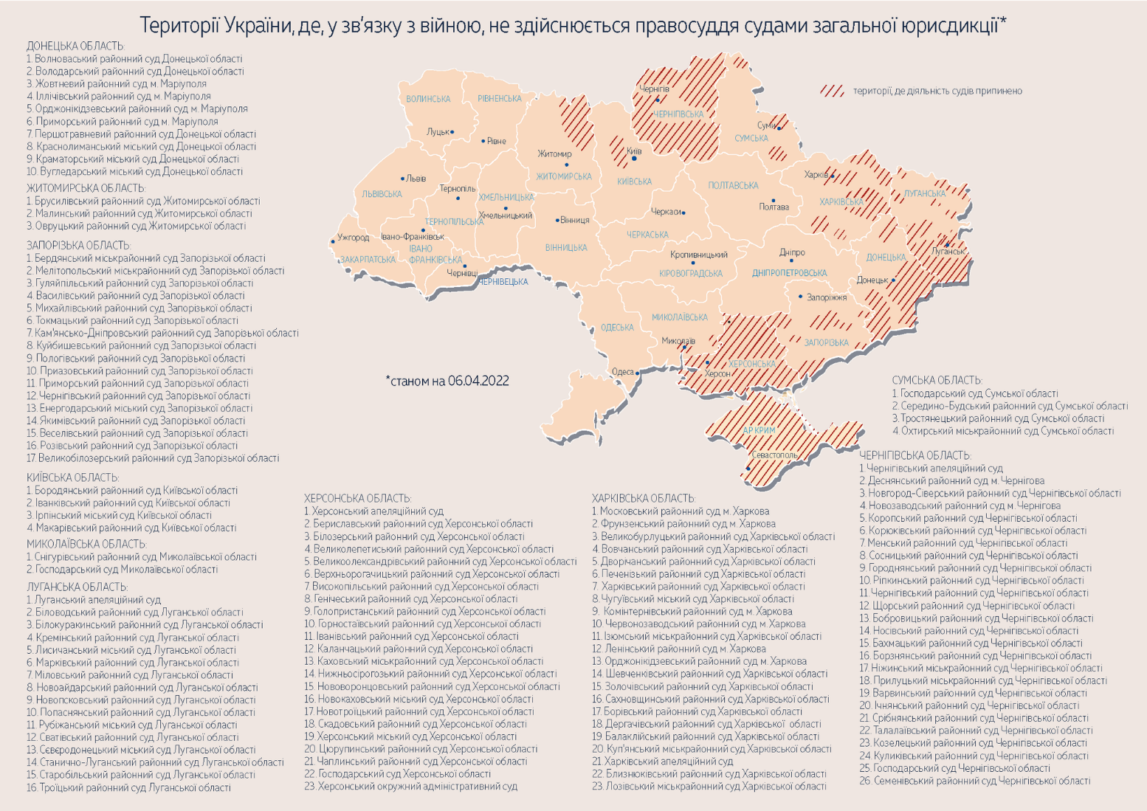
Map of the territories of Ukraine where, in connection with the war, justice is not administered by courts of general jurisdiction as of April 17, 2022

Slide 17
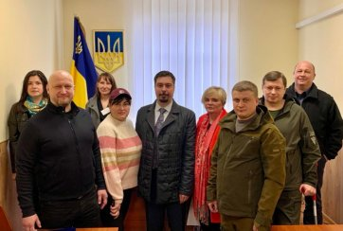
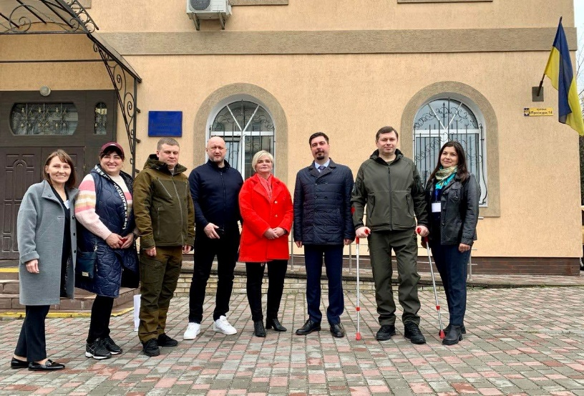
Restoration of courts
In accordance with the order of the Chairman of the Supreme Court of 21.04.2022 № 24/0 / 9-22 the territorial jurisdiction of court cases of three courts of Zhytomyr region, which have proper conditions for the administration of justice: Brusyliv, Malyn and Ovruch district courts was restored.
The order of the Chairman of the Supreme Court of April 21, 2022 № 18/0 / 9-22 restores the territorial jurisdiction of court cases of Ivankiv district court of Kyiv region. Given the proper conditions for the administration of justice, the court opened on April 22, 2022.

Slide 18
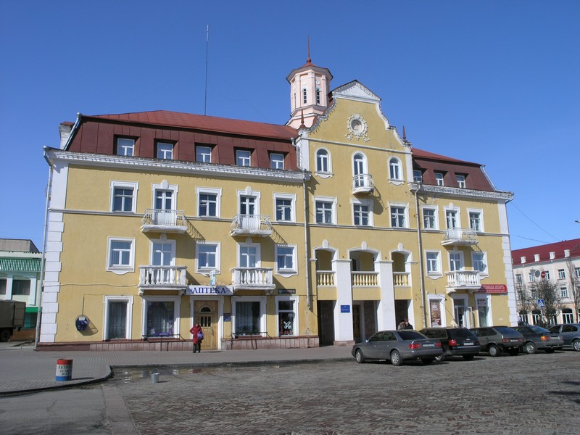
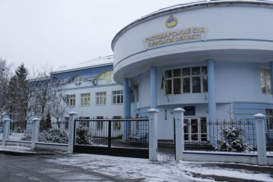
Territorial jurisdiction of court cases of two commercial courts has been restored
In accordance with the order of the Chairman of the Supreme Court dated 22.04.2022 № 25/0 / 9-22 the territorial jurisdiction of court cases of two commercial courts was restored, which have proper conditions for justice: the Commercial Court of Sumy region and the Commercial Court of Chernihiv region.

Slide 19
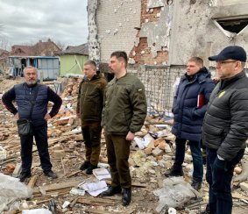
Chairman of the Supreme Court Vsevolod Knyazev:
"They can destroy temples of justice, but neither bullets nor bombs can stop justice. After all, justice is first and foremost the people who administer it and the people who need it. Living this, without exaggeration, the most dramatic period of our independent history, the judiciary, like all of Ukraine, faces unprecedented challenges. But the truth is that today we are united as never before. Therefore, a full recovery of all courts is only a matter of time. We must now focus on resuming the courts in the territories liberated from the invasion of Russian invaders. And despite the fact that this task is not easy, because the choice of surviving buildings in which the court can be "relocated" is extremely limited, we will cope with it, "Vsevolod Knyazev is convinced.

Slide 20
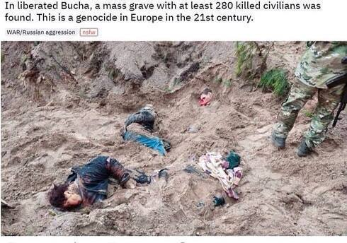
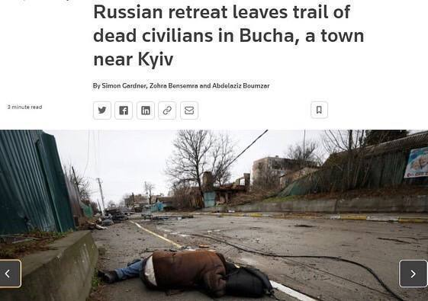
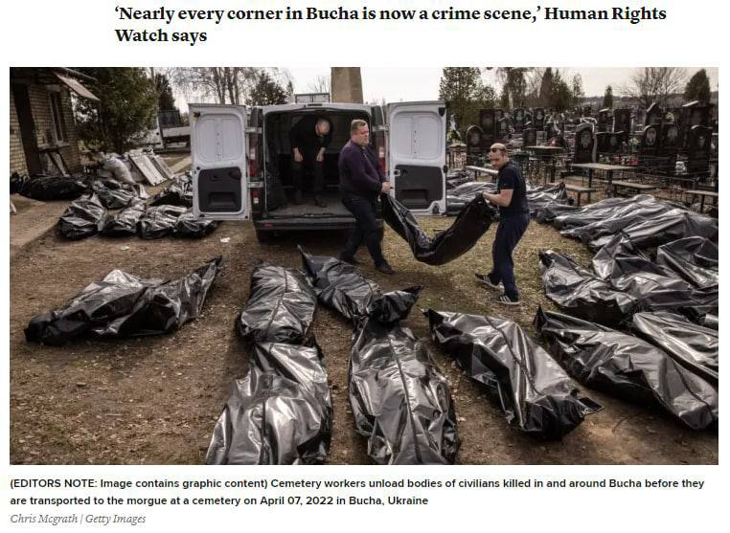

Slide 21
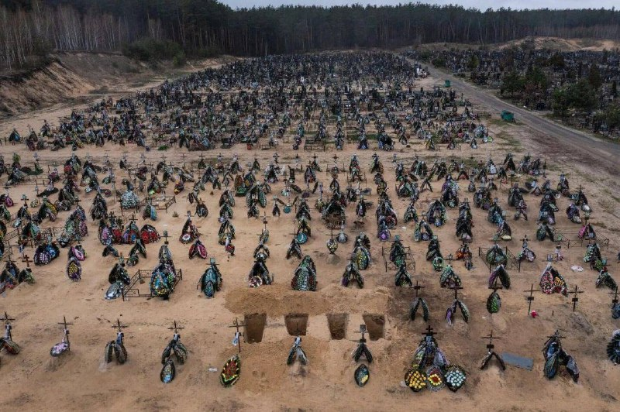
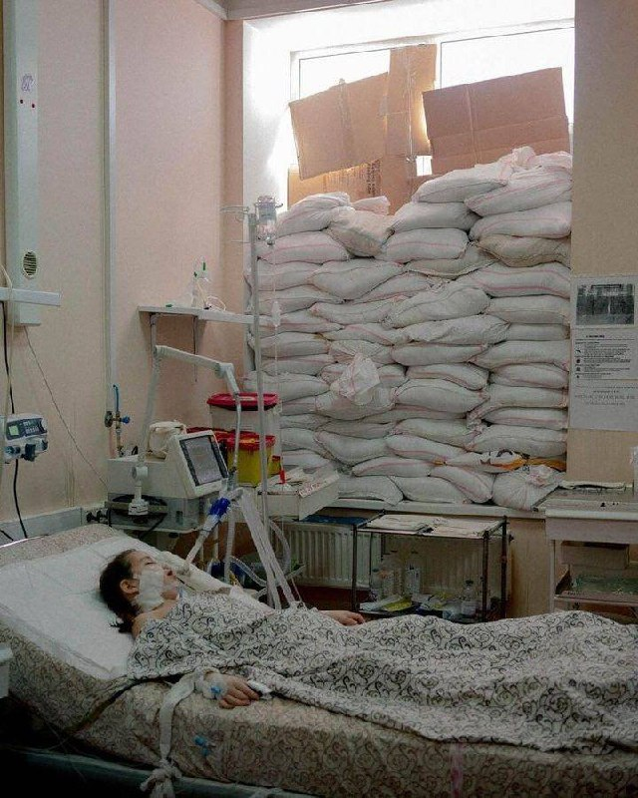
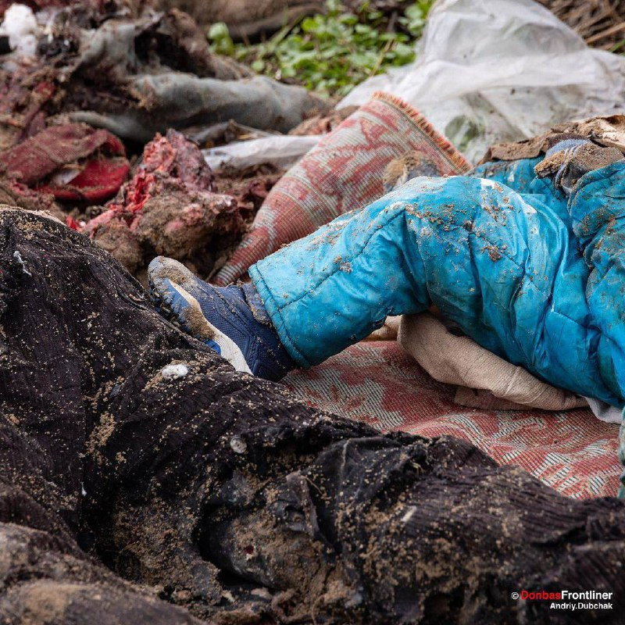

Slide 22
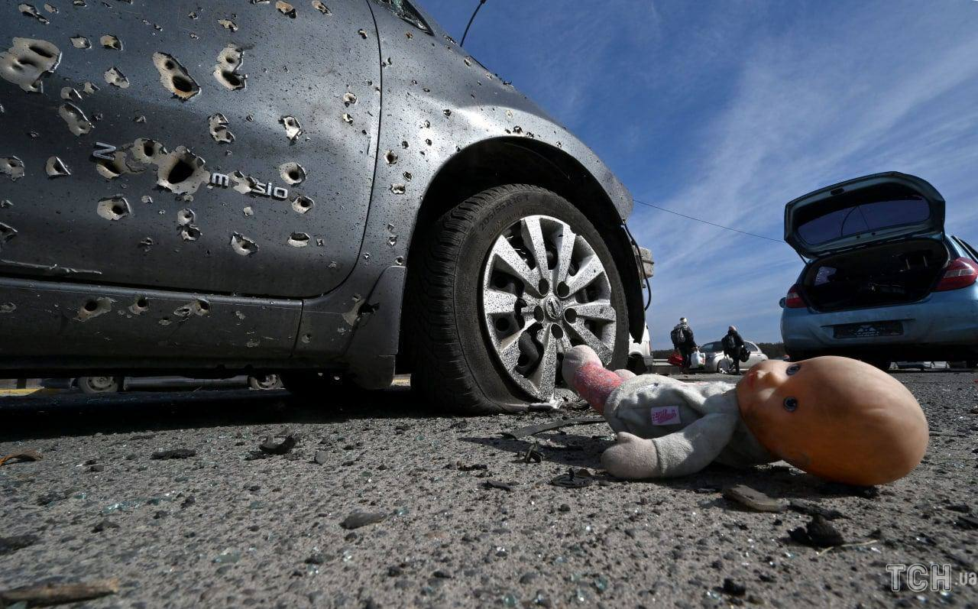
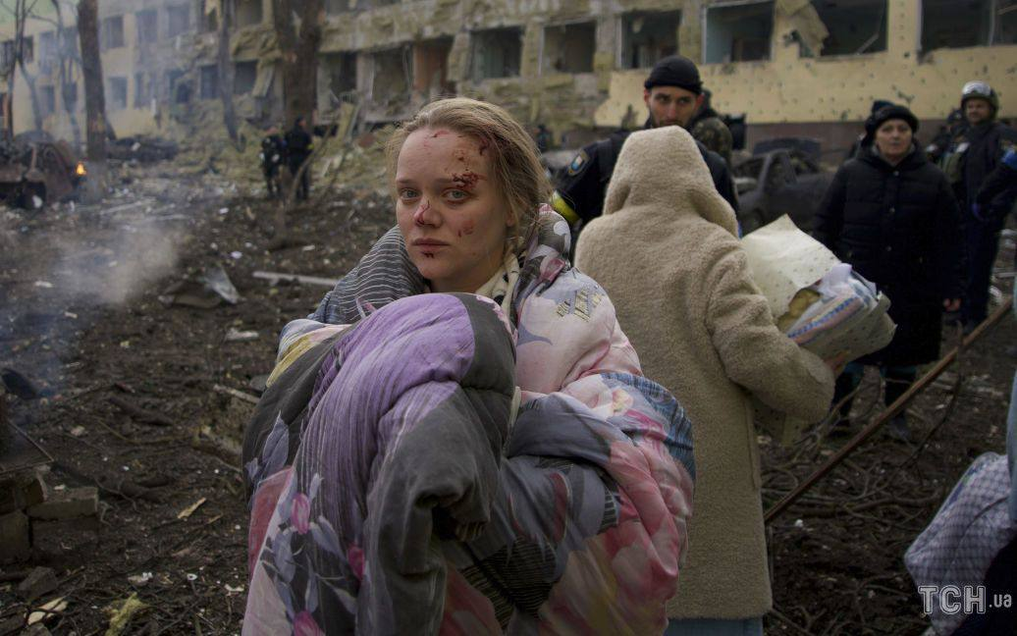
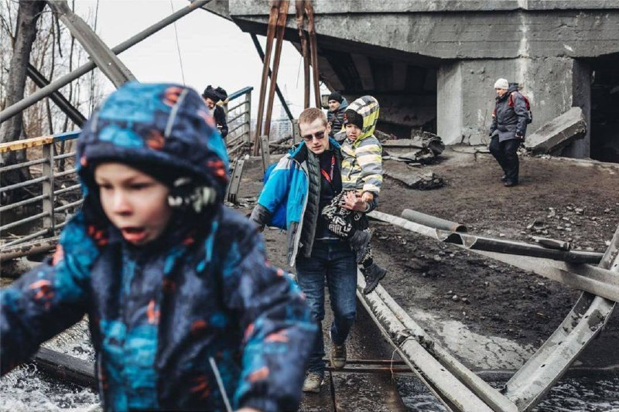
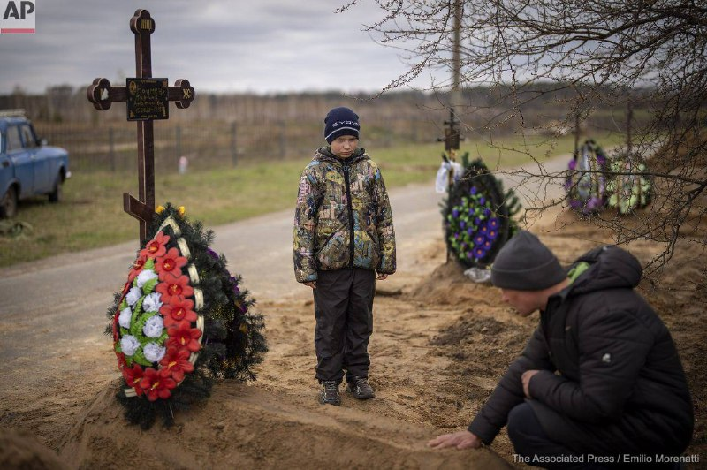

Slide 24
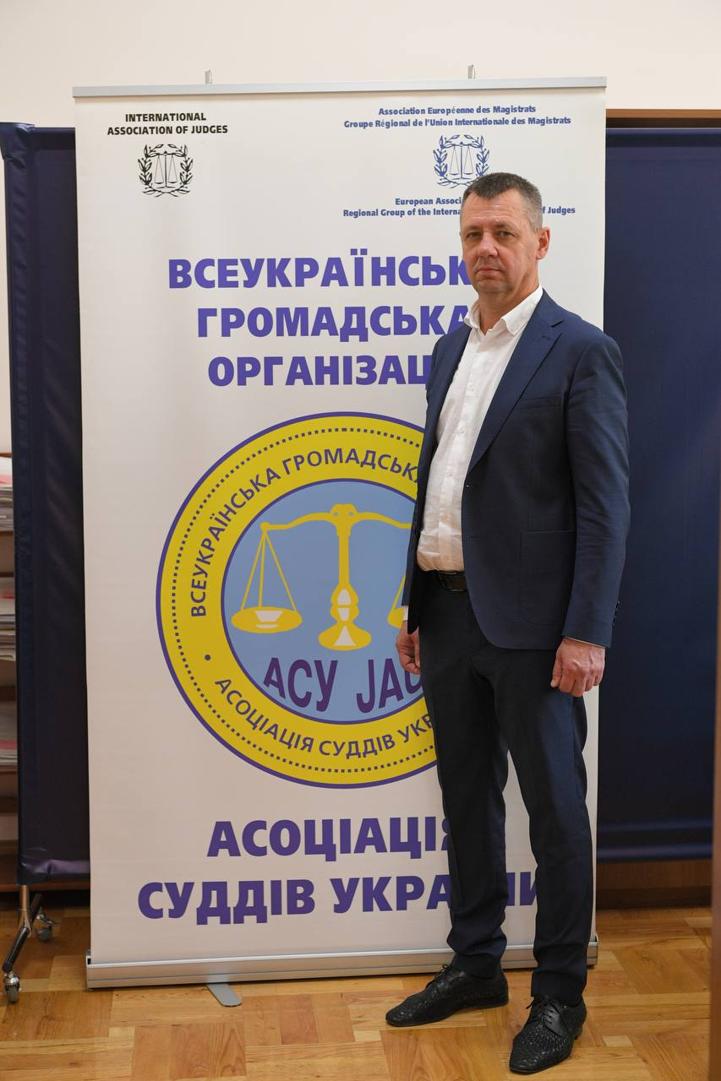
The need to create an investigative team.
President of Ukrainian association of Judges
Korotun Vadym
On September 21, 2017, the United Nations Security Council unanimously passed Resolution 2379 mandating the establishment of an Investigative Team to collect and preserve evidence for use in national courts of international crimes.
The resolution requests that the Secretary-General establish “an Investigative Team, headed by a Special Advisor” to support domestic efforts to hold ISIL accountable by collecting, preserving, and storing evidence in the Republic of Iraq of acts that may constitute war crimes, crimes against humanity, or genocide. Resolution 2379 and the Terms of Reference contemplate that evidence collected by the Investigative Team may also be used in “criminal proceedings conducted by competent domestic courts and in third States.” It is advisable to initiate the adoption of such a resolution on Ukraine!
Please adopt a resolution in support of the appeal of the Ukrainian Association of Judges to the UN Security Council to establish a special investigation team which will collect evidence of crimes committed by russian troops on the territory of Ukraine against civilians of Ukraine.
Accession of Ukraine to the European Union as soon as possible.

Slide 25
